Slide 1

MULTI-LANGUAGE TEXT EXTRACTION AND IDENTIFICATION
Final Year Project Phase-II
Batch 2020-2024
Presented By
Yuvraj Kumar - 2020105262
Zayiechutuo Lohe - 2020105263
Under the Supervision of
Dr. Shouvik Dey
National Institute of Technology Nagaland
Department of Computer Science & Engineering
Chumukedima, Nagaland-797103

Slide 2
CONTENTS
INTRODUCTION
LITERATURE REVIEW
PROPOSED MODEL
PROJECT WORK
IMPLEMENTATION DETAILS
RESULTS
CONCLUSION
REFERENCES
1

Slide 3
INTRODUCTION
Text extraction from image is one of the complicated areas in digital image processing. It is a complex process to detect and recognize text from image.
There is a need for systems that can extract against general background.
Language is a fundamental aspect of cultural identity.
Language Identification is the process of determining which natural language the given content is in.
This can help in translation of books, reading signs of a different language and many more other applications.
2

Slide 4
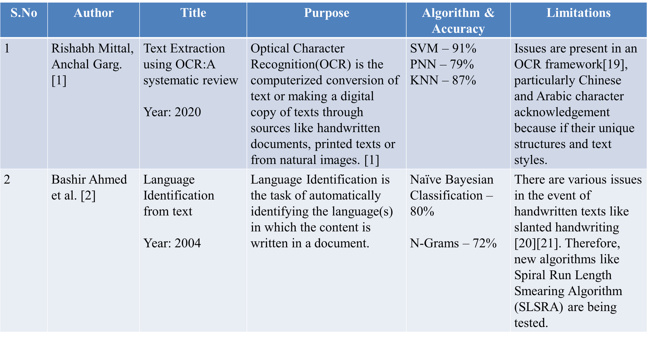
LITERATURE REVIEW
Table 1: Literature Review
3

Slide 5
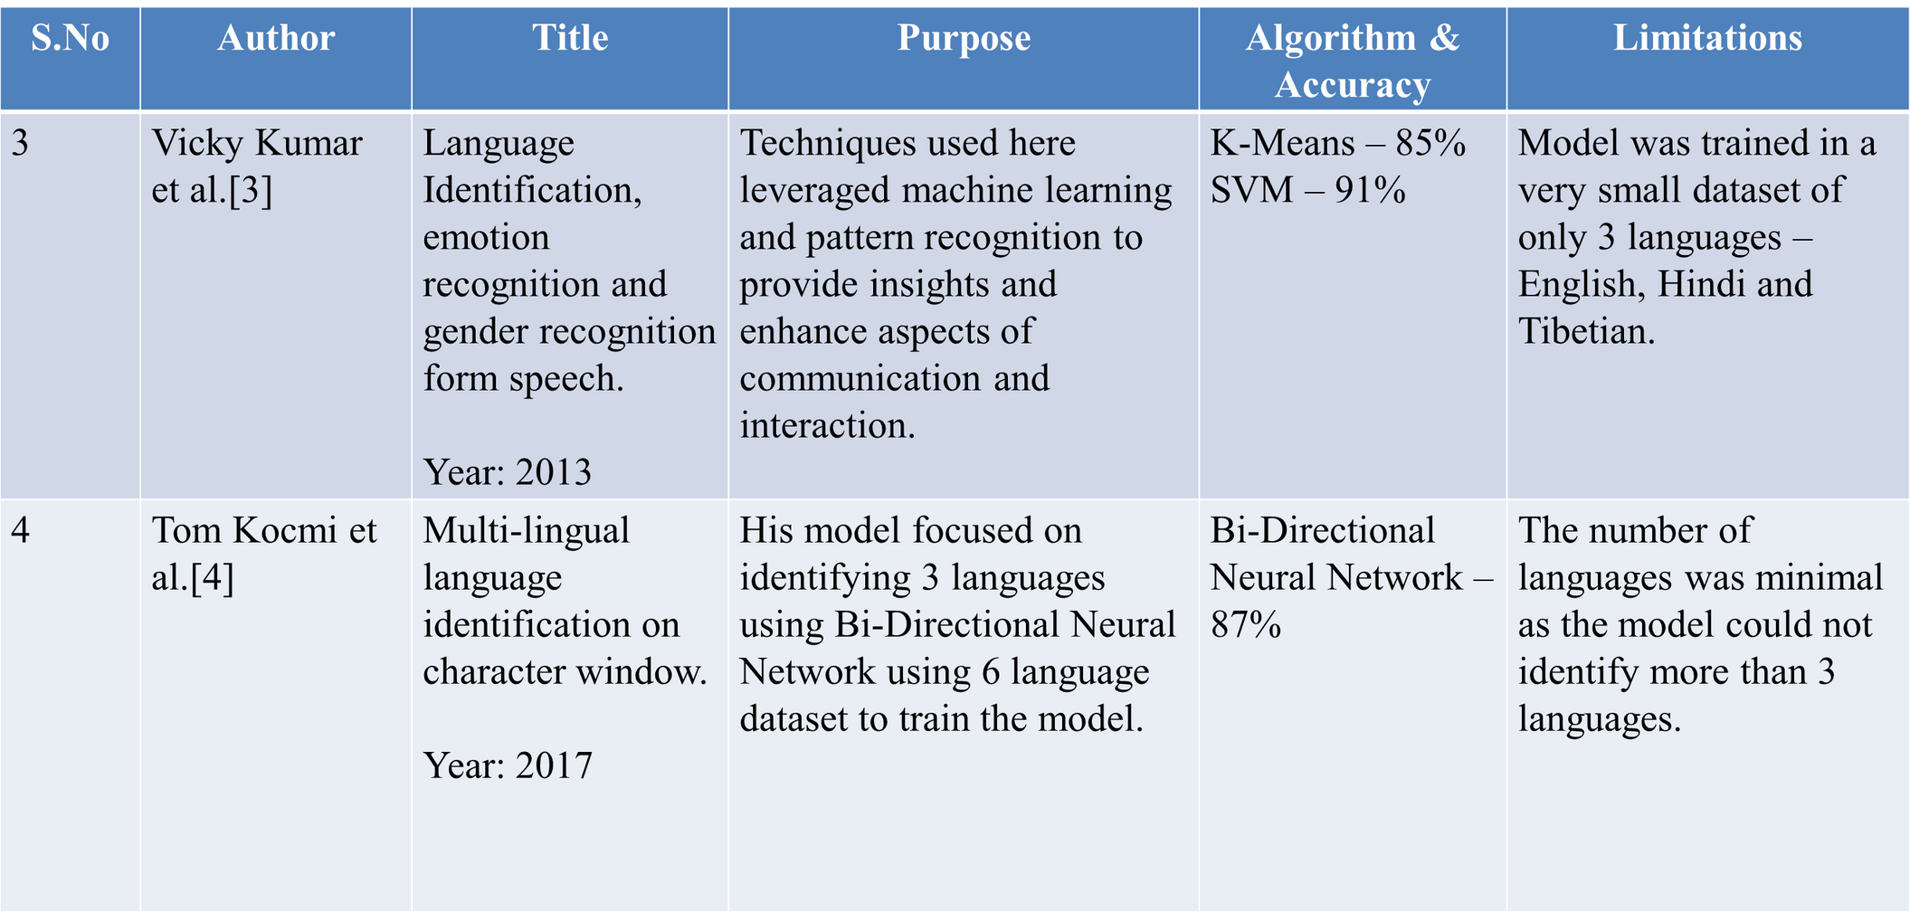
LITERATURE REVIEW
Table 2: Literature Review
4

Slide 6
PROPOSED MODEL
Input Image
Image
Pre-processing
Text Extraction
Extracted Text
Translated Text
Translation
Identified Language
Language Identification
Extracted Text
Figure 1: Proposed Model
5

Slide 7
PROJECT WORK
This Project is divided into three main phases which include extraction of text from images, identification of language and translation to Nagamese.
Before the extraction of text from the image, the image will be pre-processed if required and the enhanced or processed image will be forwarded for extraction of text using OCR.
Then various machine learning models like Naive Bayes, SVM and KNN will be used for identifying the language of the extracted text.
Then the extracted text is translated to English and then translated to Nagamese dilect.
6

Slide 8
PHASE-I RECAP
Pre-Processing of Images done using various noise filters, Adaptive Thresholding and Morphological Image Processing.
Extraction of Text using OCR has been performed.
Using language dataset from Kaggle.com, Language Identification has been done with various models such as Naive Bayes, Logistic Regression, SVM, Decision Tree and KNN.
The most accurate result was obtained using SVM with an accuracy score of 97.44%.
7

Slide 9

IMPLEMENTATION DETAILS
TECHNOLOGIES USED:
Jupyter Notebook
Python 3
OpenCV, PyTesseract, Sklearn
Matplotlib, Numpy, Pandas
Language dataset(17 Languages)
Nagamese dataset from by Zayiechutuo and Yuvraj
Kaggle.com
Language
Dataset
ML
Model
Figure 2: dataset collection
8

Slide 10
IMPLEMENTATION DETAILS
INPUT IMAGE
Morphological
Image processing
Dilation
Input Image
Noise Filter
Adaptive
Thresholding
Erosion
Enhanced Image
Opening
Closing
Figure 3: Image Pre-processing
Input image is pre-processed to filter out any noise using filters and adaptive thresholding
After that we employ morphological image processing to further enhance the image
9

Slide 11
IMPLEMENTATION DETAILS
TEXT EXTRACTION
Processed Image
OCR
(PyTesseract)
Extracted Text
Figure 4: Text Extraction
The Pre-Processed Image is then fed into OCR(Optical Character Recognition) for extracting the text from the image.
10

Slide 12
IMPLEMENTATION DETAILS
LANGUAGE IDENTIFICATION
Extracted Text
Dataset
Data
Pre-processing
Model Selection
Integration
Language Identification
Figure 5: Language Identification
The Extracted Text is then Identified with the help of the machine learning model that is trained using the language dataset.
11

Slide 13
IMPLEMENTATION DETAILS
TRANSLATION
Extracted Text
Dataset
MySQL DB
Translation
Nagamese Text
Figure 6: Translation
The Extracted text is used to find the most suitable Nagamese sentence from the database.
12

Slide 14

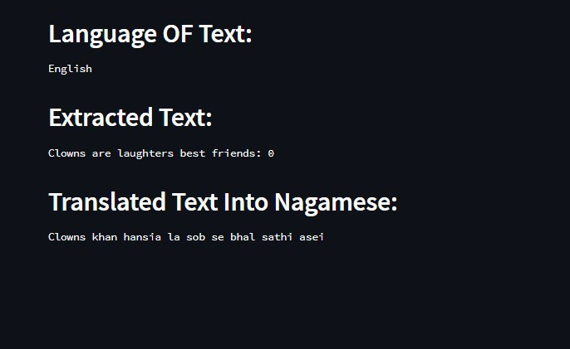
RESULTS
Input
Output
Figure 7: Input Image
Figure 8: Output Texts
13

Slide 15
RESULTS
LANGUAGE IDENTIFICATION
Table 3: Results
Model | Accuracy | Precision Score | Recall Score | F1-Score
Logistic Regression | 97.437 | 97.441 | 97.437 | 97.431
Naive Bayes | 74.177 | 89.886 | 74.177 | 72.906
Support Vector Machine | 98.210 | 98.216 | 98.210 | 98.208
Decision Tree | 89.168 | 89.291 | 89.168 | 89.199
KNN | 96.518 | 96.589 | 96.518 | 96.522
14

Slide 16
CONCLUSION
The Extraction of texts from images have been successful.
The Pre-processing of images have been implemented successfully and provides better/enhanced version of the images.
The identification of the language of those extracted text have also been tested and SVM has shown to be the model that provides the highest score (98.208) among all other models that have been tested.
Translation of the extracted text to English and then to Nagamese has been successful.
15

Slide 17
REFERENCES
[1] Mittal, R., & Garg, A. . Text extraction using OCR: A Systematic Review. 2020 Second International Conference on Inventive Research in Computing Applications (ICIRCA), 2020.
[2] Ahmed, Bashir, Sung-Hyuk Cha, and Charles Tappert. "Language identification from text using n-gram based cumulative frequency addition." Proceedings of Student/Faculty Research Day, CSIS, Pace University 12, no. 1, 2004.
[3] Verma, Vicky Kumar, and Nitin Khanna. "Indian language identification using k-means clustering and support vector machine (SVM)." In 2013 Students Conference on Engineering and Systems (SCES), pp. 1-5. IEEE, 2013.
[4] Tom Kocmi and Ondřej Bojar. LanideNN: Multilingual Language Identification on Character Window. In Proceedings of the 15th Conference of the European Chapter of the Association for Computational Linguistics: Volume 1, Long Papers, pages 927–936, Valencia, Spain. Association for Computational Linguistics,2017.
[5] Levin, A., Weiss, Y., Durand, F., & Freeman, W.T. . Blind Deconvolution Using a Normalized Sparsity Measure. European Conference on Computer Vision (ECCV), 2009.
16

Slide 18
THANK YOU
THANK YOU

